Slide 1
Big Mountain Resort Ticket Pricing Analysis
Capstone Project - 1 Springboard
By - Anshul Dang

Slide 2
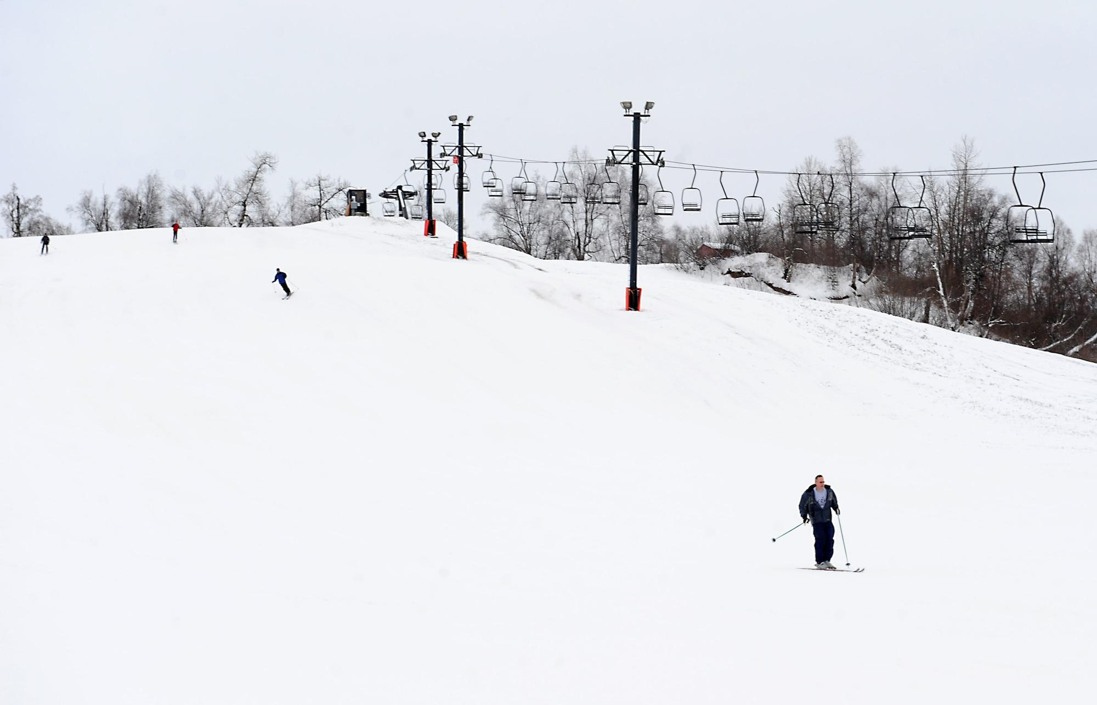
Problem Statement
Big Mountain Resort charges $81 for weekend tickets.
Management suspects underpricing
Goal: Use data-driven model to predict fair price & key drivers
Success criteria < 15% mean absolute error

Slide 3
Data Overview
~330 resorts, 27 features.
Facility-based features (elevation, runs, lifts, snowmaking, snowfall).
Enriched with state-level data(population, area).
Final dataset: 277 resorts x 26 features.

Slide 4
Data Wrangling & EDA highlights
Cleaned missing values & outliers (e.g., Silverton area fixed).
Dropped low-value columns (fastEight).
PCA: Vermont & New Hampshire stand out (high density).
Correlations: vertical drop, runs, lifts, snowmaking leads to higher price

Slide 5
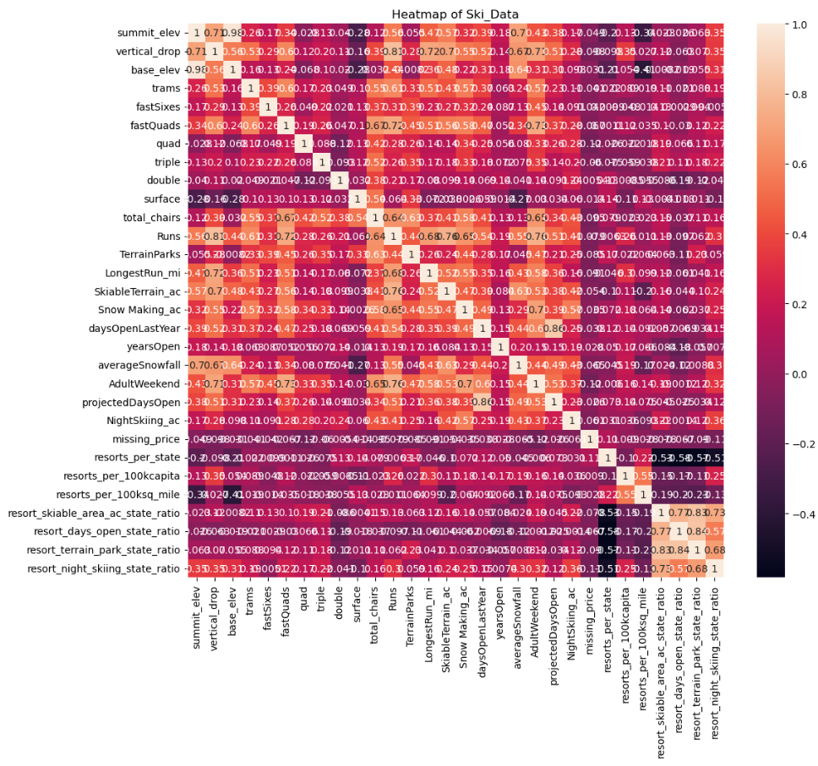

Slide 6
Modeling Approach
Baseline → predict mean price (weak).
Linear Regression → better fit, interpretable.
Random Forest → robust, best accuracy.
Evaluation: train/test split, 5-fold CV.

Slide 7
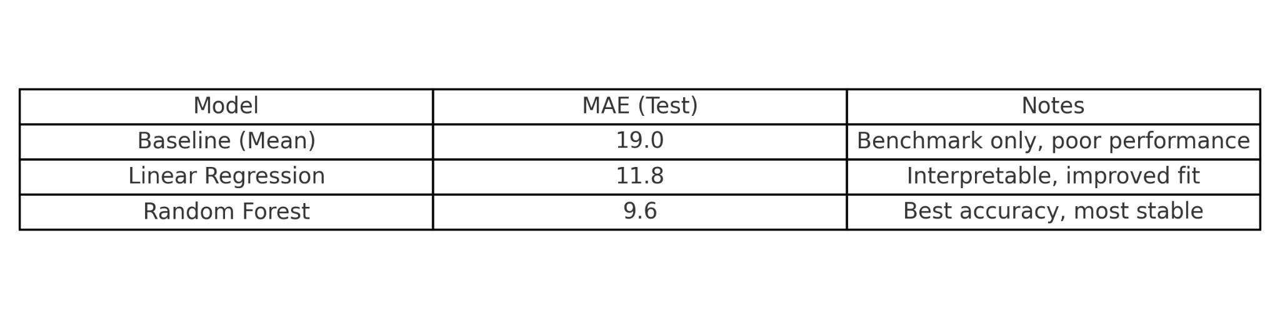
Model Performance

Slide 8
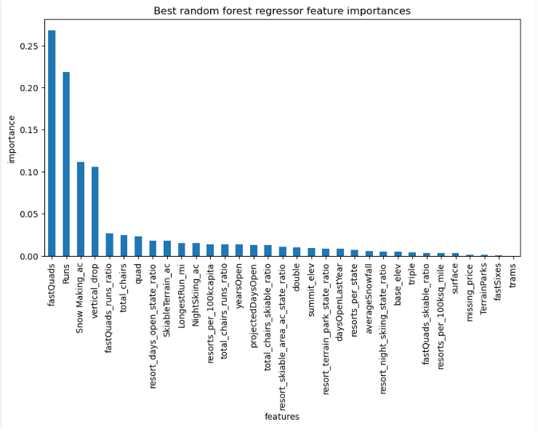
Feature Importance
fastQuads, Runs, Snow Making_ac, Vertical Drop are the strongest drivers of price
Results are consistent with both linear and random forest models
Confirms operational features (not branding/marketing) drive value

Slide 9
Scenario Analysis - Revenue Impact
Scenario 1: Closing runs reduces revenue after 2–3 closures → risky
Scenario 2: Add 1 run, 150 ft vertical, +1 chair → +$2.25 ticket, +$394K revenue
Scenario 3: Scenario 2 + snowmaking → no extra effect
Scenario 4: Longer run + more snowmaking → no significant effect
Best option: Scenario 2

Slide 10
Final Recommendations
Big Mountain is currently undervaluing tickets (~$19.55 gap vs predicted price)
Focus on investments that directly impact skier experience (lifts, vertical drop, runs)
Scenario 2 is the most cost-effective strategy
Avoid closures unless operationally necessary (revenue drop risk)
Next steps: monitor visitor response + collect more cost/usage data

